Slide 1

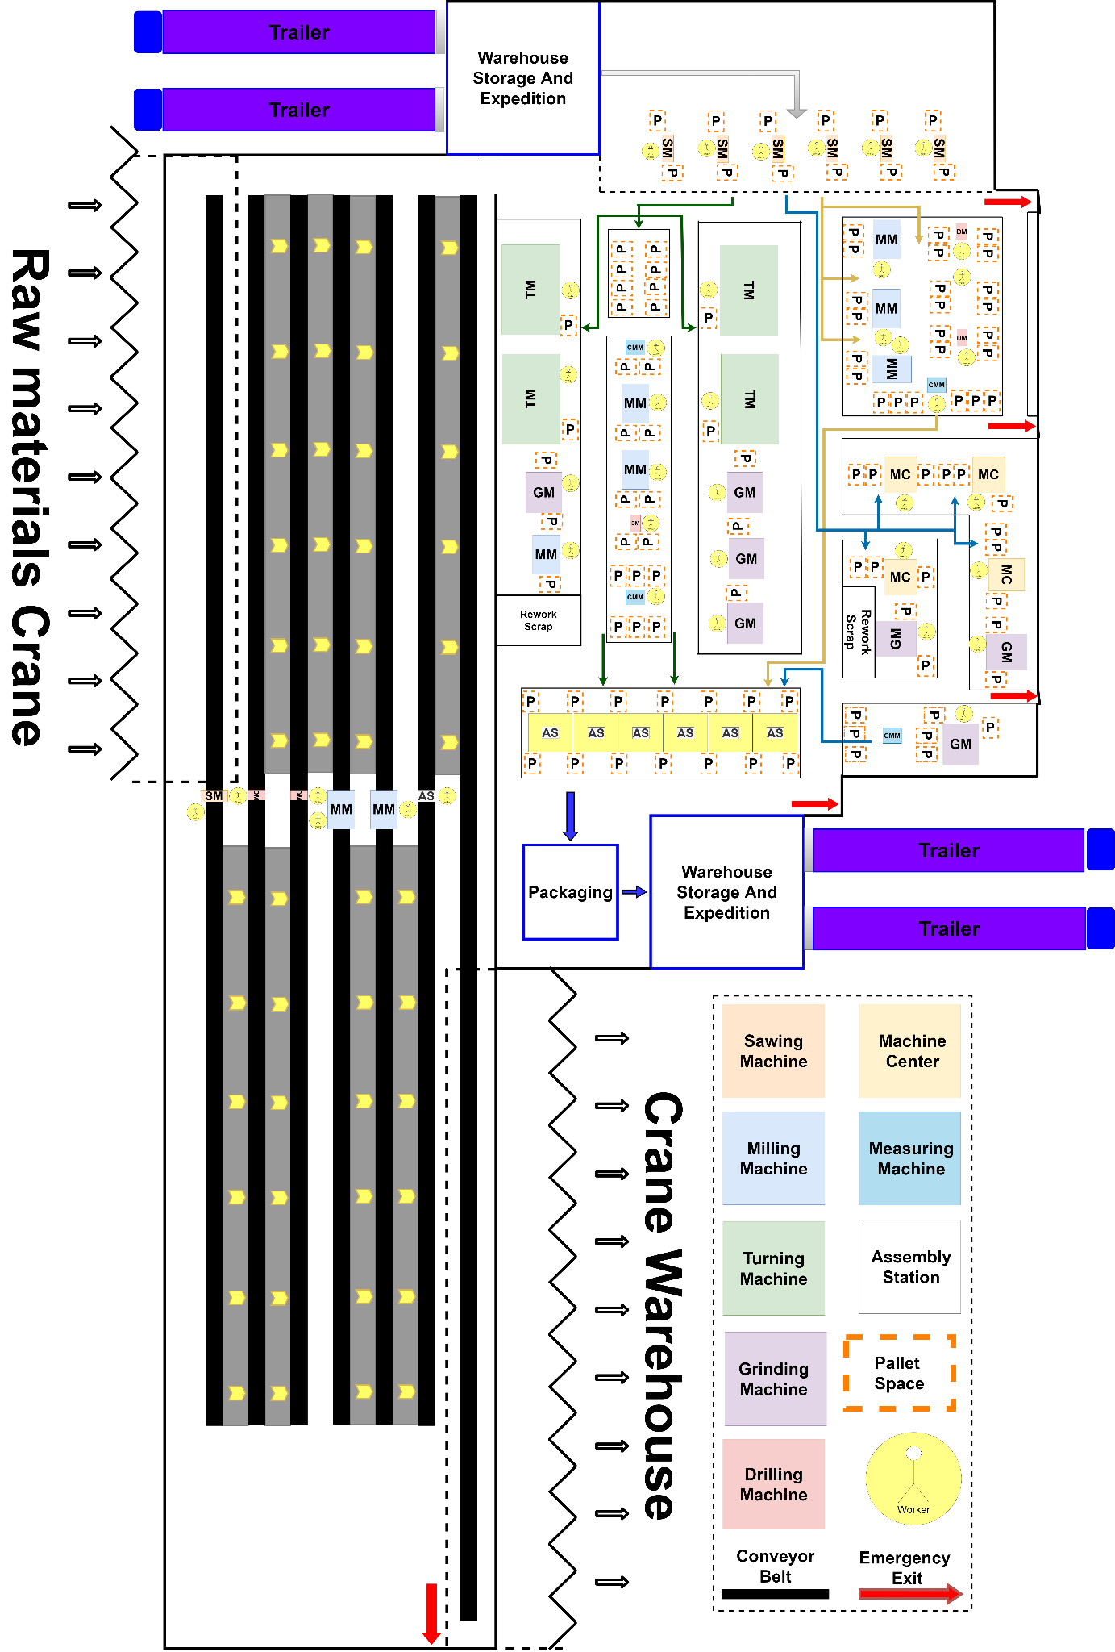
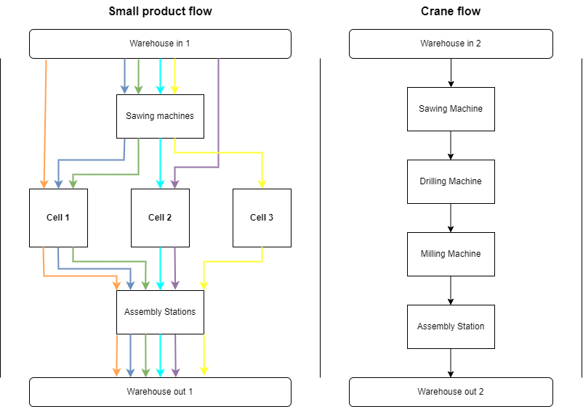
ME Module 11 : Production Systems Engineering
Group 2 | Faculty of Engineering Technology (ET)
University of Twente, Netherlands | 2022
Process Flow & Design
Joep Nijhuis (s2384779),
Mick Oude Engberink (s2334240)
Tijn Groeneveld (s2366118)
Introduction
Floor Layout
The subsystem Process Design is concerned with the flow of resources through the new facility. This means that this subsystem will design the layout of the factory, placement of machines and overview the flow of resources throughout the factory based on the input of the Planning & Control subsystem and requirements set up for this subsystem. Also the warehousing needs to be considered, not the inventory system itself, but the placements and size is an important aspect of the facility. Naturally it is important to keep transportation of products as small as possible whilst allowing worker and storage space between transportation routes which are considered in the Requirements & Guidelines.
Requirements & Design Guidelines
The facility design guidelines will differ from the current production portfolio and the new crane parts that have to be manufactured. This is due to the large difference in size and weight. All current products can be lifted by hand manually onto pallets, whereas a different solution is needed for the crane components. Therefore there is a difference in the basic design guidelines, and this will also result in different layouts.
Guidelines:
Current production system
The maximum transportation batch size fits on an area equivalent to a Euro Pallet.
Walkways should be 1.5 meters wide at minimum.
Transportation ways within cells should be 1.5 meters wide.
Transportation ways between cells used by electric pallet jacks should be at least 2 meters wide.
Every machine inside a cell should have space for 2 pallets ideally, one for current production and an extra for a new batch.
At the end of the cell there should be 3 pallet places, accounting for a delay in the full transportation of completed batches.
Finished products of a cell should be easily collectible by electric pallet jacks en the end of a production cell for pre-assembly storage.
New production system:
Feeding of the construction elements through processing steps is done via conveyer belt, since it will be the easiest way of transport compared to an overhead crane whilst being space efficient as well.
The production line layout should go directly from raw material storage to finished product storage without space for WIP storage in between.
General guidelines:
Worker space in front of a machine should be at least 1 square meter.
Space around machines for walking around and considering easy access for maintenance should be at least 1 meters.
Production Flow
Since the production portfolio of the factory includes products of totally different sizes the production flow has been split in two sections. The structural beams of the crane have been assigned both a separated warehouse and a separated production line because these elements are much bigger than the rest of the products produced within the factory. The production of the crane elements will be produced using a production line. The crane construction elements will be transported between machines using conveyor belts. The production of the rest of the products will be done using both a functional layout and a cell layout. In the figure below it can be seen that the sawing machines are all located together at the front of the production system. In addition the assembly tables are located together at the end. These two instances indicate a functional layout. In between the sawing machines and the assembly table however, the machines are located in three cells, which indicates a cell layout. In the figure the flow of products between the different sections and cells can be found.
The layout and design of the factory has been designed with the requirements and design guidelines in mind. This means that the spacing between machines and walkways within and without cells have the required measurement. Transportation of the crane elements is realised with a sideways conveyor transportation system. If additional space was present in the factory, this could be a temporary hold for products that require rework if the fault was already identified during production. In the end the estimated dimensions of the crane production facility is around 20x90 meters, or 1800 square meters. The current product portfolio production system will take up roughly 1750 square meters, including storage. Note that the warehousing of the crane elements is not completely on the layout, but can be found for the subsystem Finance and Inventory Management.
Machine types in Cells
Cell 1: TM, MM, DM, GM, CMM
Cell 2: MC, GM, CMM
Cell 3: MM, DM, CMM
Conclusion
Keeping into consideration all the specified requirements, design guidelines, time efficiency and safety a final layout for the factory was created and can be found in the picture above. The final layout is split in two sections which are the section for the big crane elements on one side and the production section for the smaller components on the other side. The crane elements are produced in a production line while the smaller components are made using a cell layout integrated inside a functional layout. It is made sure that the workers have enough space around the machines and that the transport roads are broad enough. In addition, every machine is assigned two pallet places to make sure the workers have enough space to store the unfinished components in between two machining processes. To make sure the layout is as time efficient as possible a close relationship between the Process Design subsystem and the Planning and Control subsystem was maintained. The cells are placed throughout the factory such that the workers spend the least time as possible for moving the products between the cells. In order to maintain a safe work environment safety exits are provided in the layout design. These assure the workers can escape the factory in case of emergency.
UNIVERSITY OF TWENTE

